Slide 1

3-phase Fault Detection Of Transmission Line Using MATLAB Simulink .
SUBMITTED BY :- GUIDED BY:-
Shubham Pandey.(3932515034) PROF. Sankalp Verma
Trivandra Malakar.(3932515037) (Dept. Of EEE)
Pankaj Kumar Verma.(3932515020)

Slide 2
Project Outline:-
Fault IDENTIFICATION
Waveform analysis
Classification Of FAULTS
Sampling of obtained waveform
Generating plots from sampling
Creating database for algorithms
Smart Way Of Fault Analysis

Slide 3
Presentation overview:-
Introduction
Project Methods
Models
Transmission line model
Current progress
Future work
References

Slide 4
Introduction:-
Locate fault in high voltage transmission line.(400kv)
Classification of fault
Waveform analysis
Advance method
Fault inception angle analysis
close loop system

Slide 5
Start
Deciding the model type.
Modelling of the network
To avoid the overlapping and mixing of the undesired recorded data.
Applying conditioning circuit.
Components selection.
Creating database for different fault type.
MULTIPLE INPUT SINGLE OUTPUT SYSTEM.
EVALUATION OF PERFORMANCE
USING ANN.
Stop

Slide 6
Project models:-
300km(100km+100km+100km) uncompensated transmission line. (400kv)
Sources- 400kv, 1.2GVA, 50HZ, 3 PHASE
CIRCUIT BREAKERS
STANDARD BUS SYSTEM(PHASE TO PHASE)
Load with the rating of
L1: 400kv, 50Mw, 50MvAr, 3 phase
L2: 400kv, 100Mw, 100MvAr, 3 phase

Slide 7
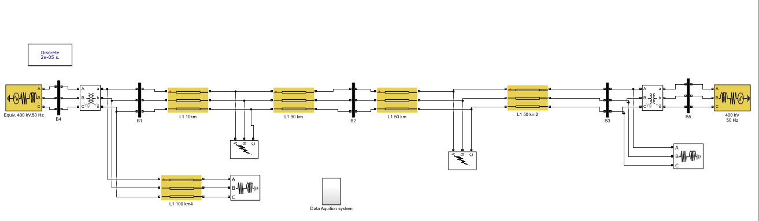
Source 1:- 400kv, 1.2GVA, 50Hz, 3 phase
Source 2:- 400kv, 1.2GVA, 50Hz, 3 phase
Load 1:- 400kv, 50MVAR, 50MW, 50HZ
Load 2:- 400kv, 100MVAR, 50MW, 50HZ

Slide 8
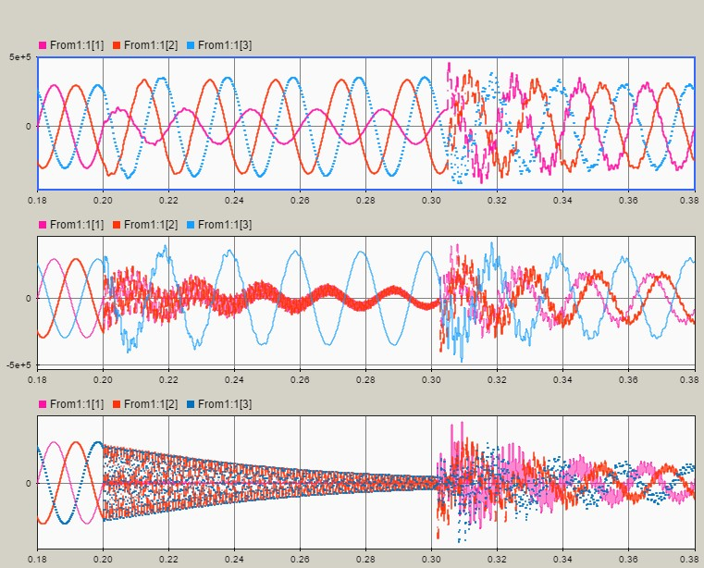
voltage waveform without filter:-

Slide 9
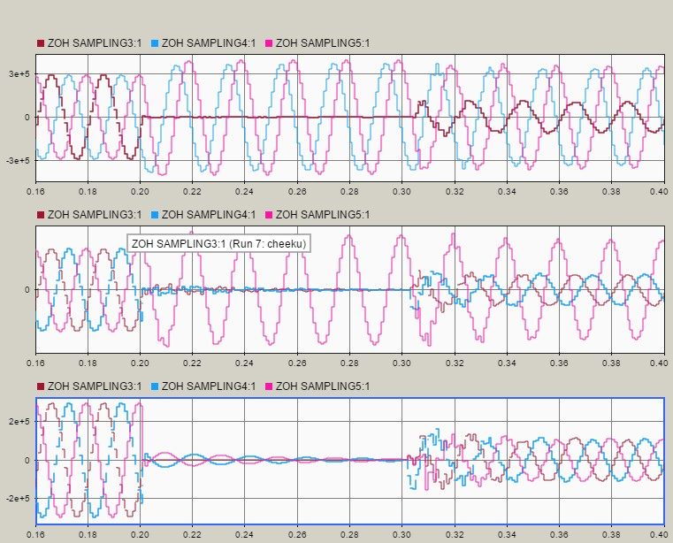
Voltage waveform with filter circuit:-

Slide 10
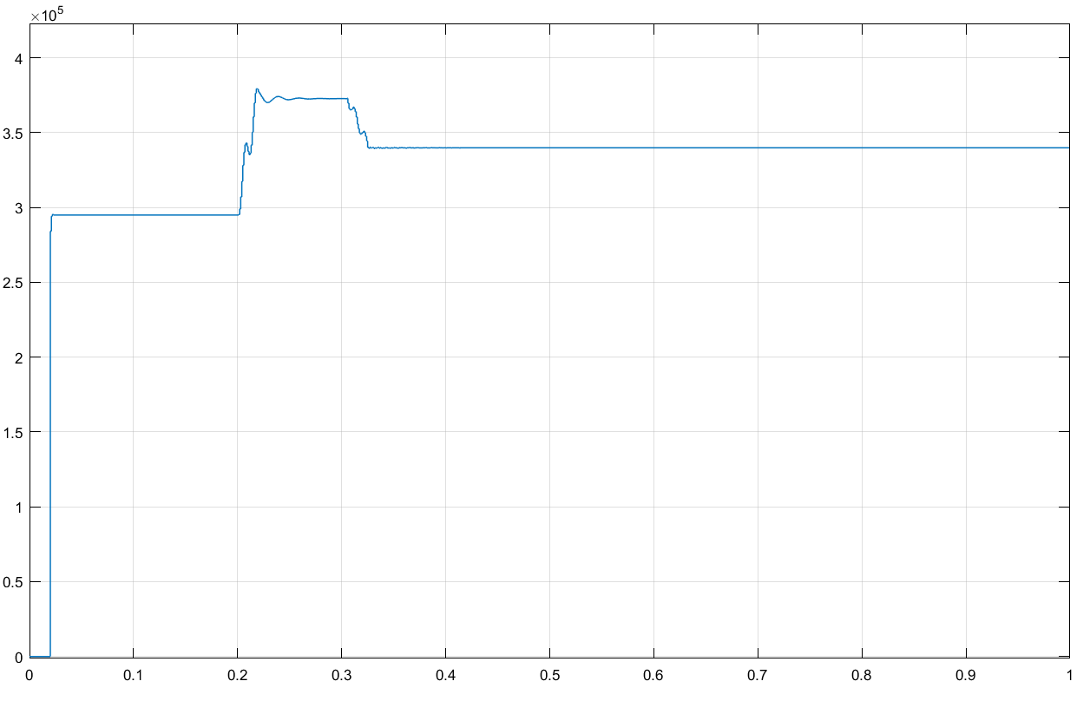
Sampled data plotting:-

Slide 11
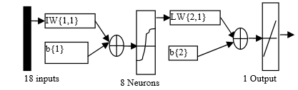
ANN MODELLING:-
Selection of Inputs and Outputs of Neural Network
ANN Architecture : HIDDEN LAYERS.
Training Process
CHECKING ERROR.
Evaluation of output.

Slide 12
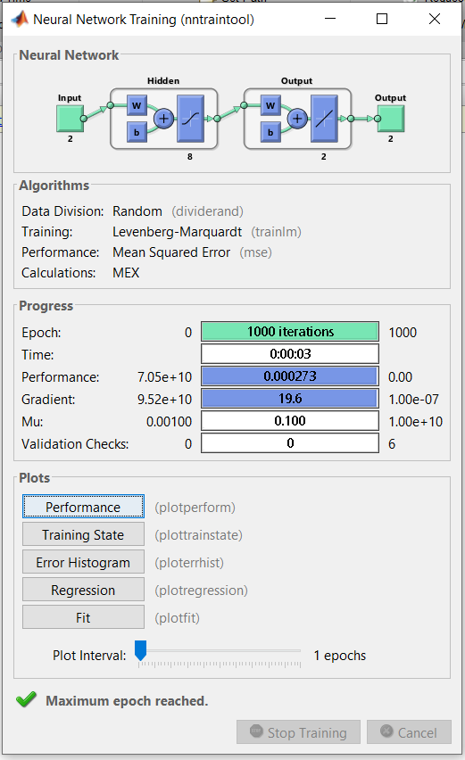
Training pocess:-

Slide 13
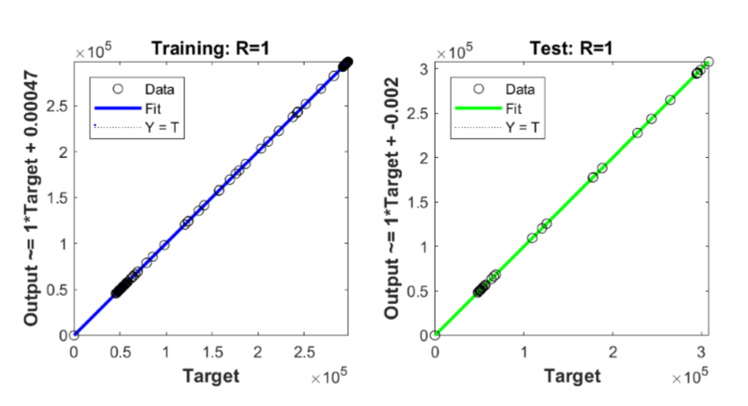
ANN output evaluation:-

Slide 14
Future scope:-
Can be interface with new algorithms
Can be implemented with the live system
Smart grid
Study and analysis of current operating scheme.

Slide 15
References
M. Kezunovic “A Survey of Neural Net Applications to Protective Relaying and Fault Analysis,” Engineering Intelligent Systems, vol. 5, no. 4, Dec1997.
M. Kezunovic, I. Rikalo, and D. Sobajic, “Real-Time and Off-Line Transmission Line Fault Classification Using Neural Networks”, Intl. Journal of Engineering Intelligent Systems, vol. 4, no. 1, Mar.1996.
S. Haykin, Neural networks: a comprehensive foundation, Prentice Hall, Upper Saddle River, NJ, USA, 1999.
A. K. Jain, J. Mao, and K. M. Mohiuddin, Artificial Neural Networks: A Tutorial, Computer, pp. 31-44, Mar1996.
K. S. Swarup and H. S. Chandrasekharaiah, "Fault detection and diagnosis of power system using artificial neural networks", Proc. 1st Int. Forum on Applicat. Neural Networks to Power Syst., pp.102 -106, 1991.
K. R. Niazi, C. M. Arora, and S. L. Surana, Power system security evaluation using ANN: feature selection using divergence, Electric Power Systems Research, vol. 69, issues 2–3, pp. 161-167, May 2004.

Slide 16
References
T. Dalstein and B. Kulicke "Neural Network Approach to Fault Classification for High Speed Protective Relaying", IEEE Trans. on Power Delivery, vol. 10, no. 2, pp. 1002 -1009, 1995.
E. E. Vazquez, H. Altuve, and O. Chacon, "Neural network approach to fault detection in electric power systems", IEEE Trans. Power Delivery, vol. 11, pp. 2090 -2095, 1996.
A.P. Alves da Silva, A. H. F. Insfran, P. M. Da Silveira, and G. L. Torres, "Neural networks for fault location in substations," IEEE Trans. Power Delivery, vol.11, no.1, pp. 234-239, Jan 1996.
M. Kezunovic and I. Rikalo, "Detect and classify faults using neural nets," IEEE Computer Applications in Power, vol.9, no. 4, pp. 42-47, Oct. 1996.
E. H. P. Chan, "Application of neural-network computing in intelligent alarm processing (power systems)," Power Industry Computer Application Conference (PICA), pp. 246-251, 1-5 May 1989.
ECEN 679 Reading – J.G. Webster, Wiley Encyclopedia of Electrical and Electronics Engineering, Wiley & Sons, 1999. (Chapter: M. Kezunovic and H. Drazenovic-Perunicic, Fault Location)

Slide 17
THANK YOU

